Slide 1
Aims of this lecture
Introduction to robot kinematic
Understanding how kinematics are vital to a robot’s operation
Understanding robot work volume
Notes:
1

Slide 2
Robot Kinematics

Slide 3
Kinematics
Kinematics is the mathematics which describe the position and motion of a robot
Two types
Forward kinematics
Given the joint angles/positions find location of robot end
Inverse kinematics
Determine joint angles/positions to achieve a given location
Generally much more useful

Slide 4
Kinematics
When programming robot control does the maths
If designing a robot or similar need to know the kinematics

Slide 5
Forward Kinematics

Slide 6
Forward Kinematics
Gives Cartesian coordinates
Coordinates relative to origin at base of robot
The kinematics of multi-joint robots working in three dimensions can be very complex
Will only analyse planar robot
Robots that operates in just two dimensions
Will only look at robots whose kinematics can be solved using basic geometry

Slide 7
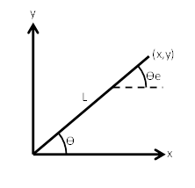
Forward Kinematics
1R Manipulator
Very simple robot with just 1 revolute joint
Joint angle is given by Ѳ
Link length given by L (this is fixed)
x and y are coordinates of end of robot relative to the origin
Ѳe is angle of the end of the robot relative to horizontal

Slide 8
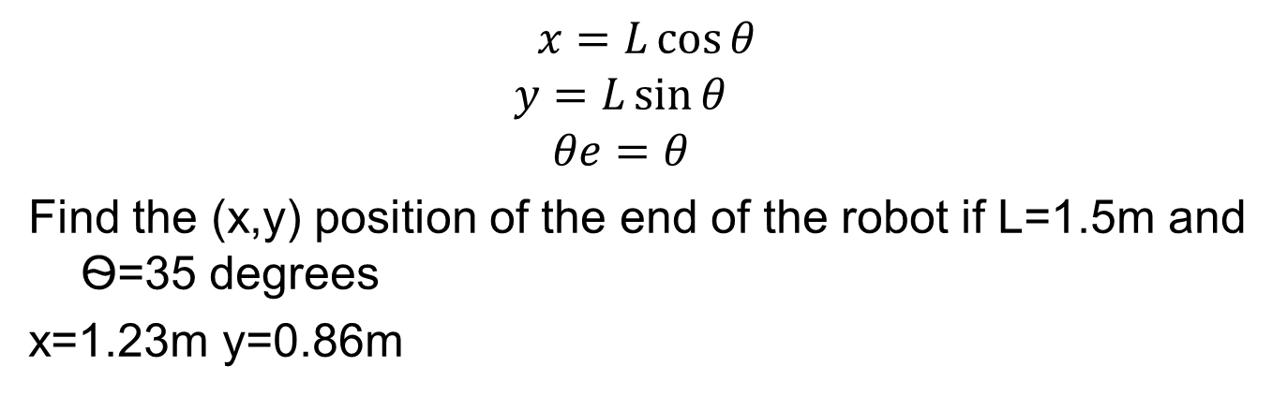
Forward Kinematics
$$x=L\cos{θ}$$
$$y=L\sin{θ}$$
$$θe=θ$$
Find the (x,y) position of the end of the robot if L=1.5m and Ѳ=35 degrees
x=1.23m y=0.86m

Slide 9
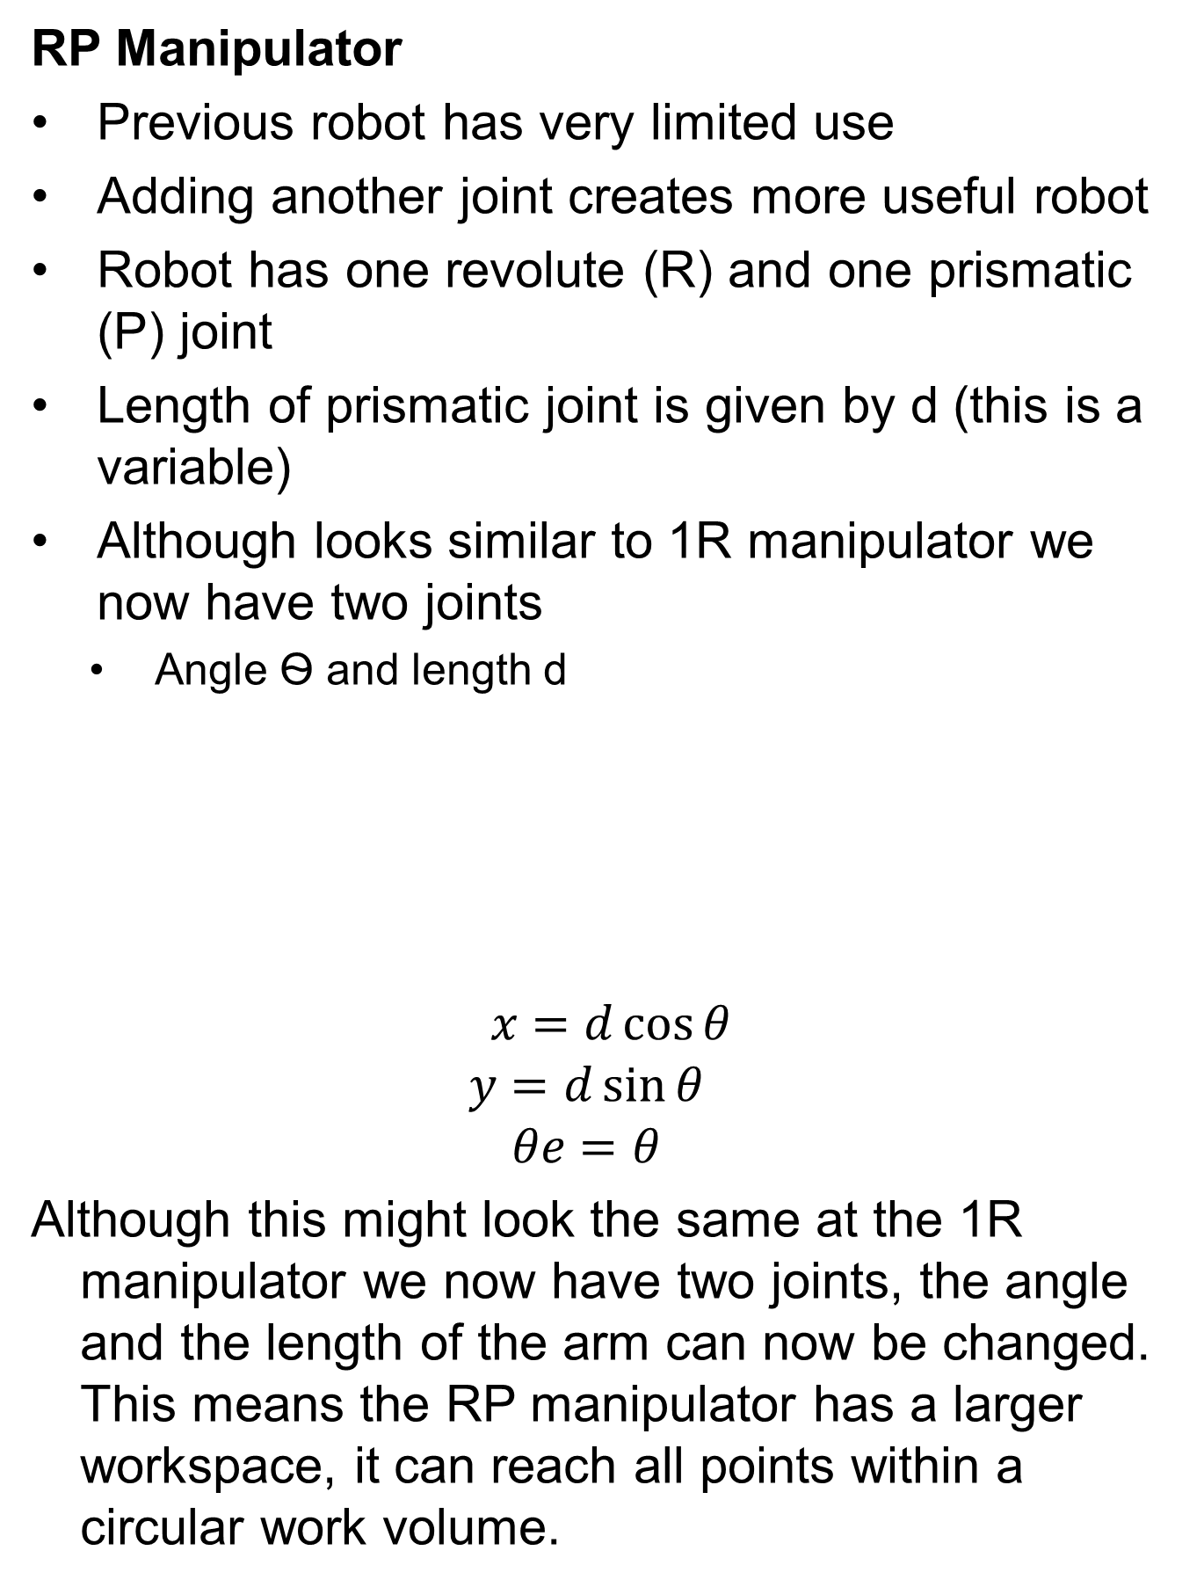
Forward Kinematics

Slide 10
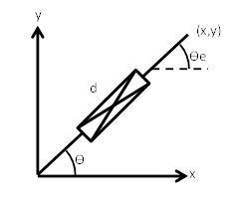
Forward Kinematics
Determine the forward kinematics
X=
Y=
Ѳe=

Slide 11

Forward Kinematics
Determine the forward kinematics

Slide 12
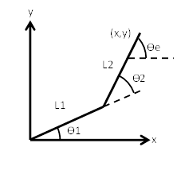
Forward Kinematics
2R Manipulator
Another two degree of freedom design
2 fixed link lengths, 2 variable joint angles
Look how the joint angles are defined

Slide 13
Forward Kinematics
Determine the forward kinematics
X=
Y=
Ѳe=

Slide 14
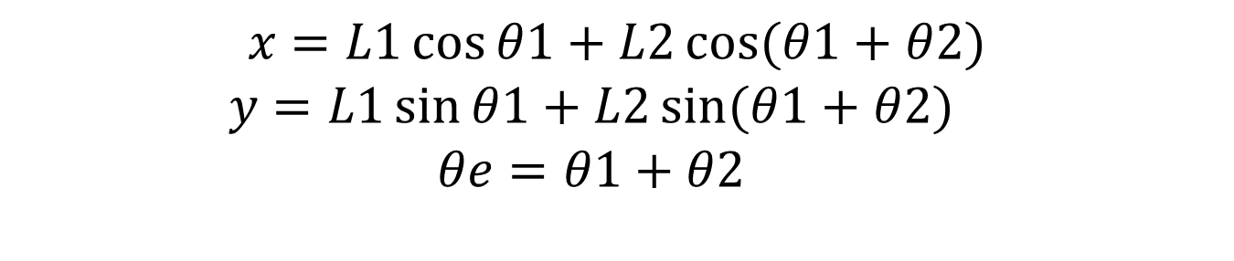
Forward Kinematics
Ѳ1

Slide 15
Forward Kinematics
Find the (x,y) position of the end of the robot and its orientation if L1=1.5m, L2=1m Ѳ1=35 and Ѳ2=40 degrees

Slide 16
Forward Kinematics
Find the (x,y) position of the end of the robot and its orientation if L1=1.5m, L2=1m Ѳ1=35 and Ѳ2=40 degrees
x=1.49m y=1.83m Ѳe=75˚

Slide 17
Forward Kinematics
Find the (x,y) position of the end of the robot and its orientation if L1=4.5m, L2=4.5m Ѳ1=0 and Ѳ2=180 degrees

Slide 18
Forward Kinematics
Find the (x,y) position of the end of the robot and its orientation if L1=4.5m, L2=4.5m Ѳ1=0 and Ѳ2=180 degrees
x=0.0m y=0.0m Ѳe=180˚

Slide 19
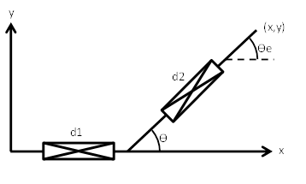
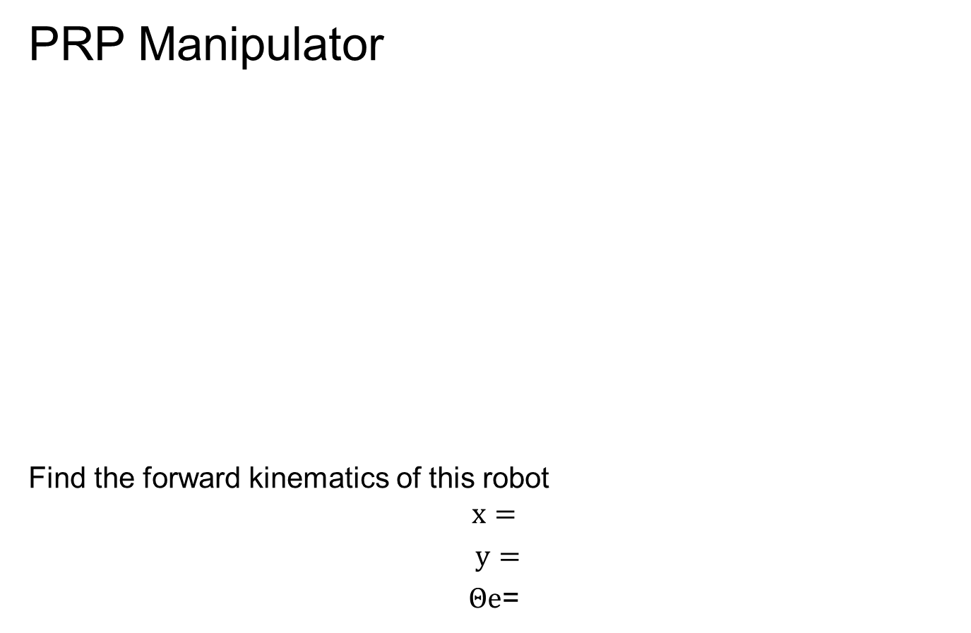
Forward Kinematics
PRP Manipulator
Find the forward kinematics of this robot
$$x=$$
$y=$
$Θe$=

Slide 20
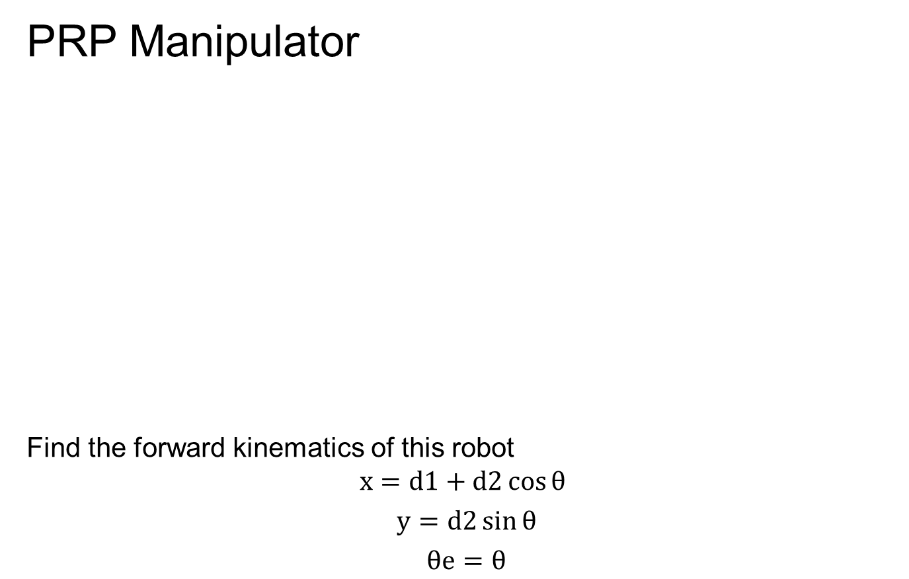
Forward Kinematics
PRP Manipulator
Find the forward kinematics of this robot
$$x=d1+d2\cos{θ}$$
$y=d2\sin{θ}$
$θe=θ$

Slide 21
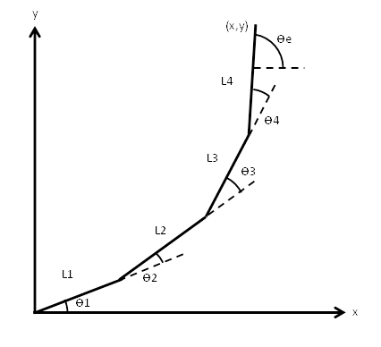
Forward Kinematics
4R Manipulator
Determine the forward kinematics of this 4R robot.

Slide 22
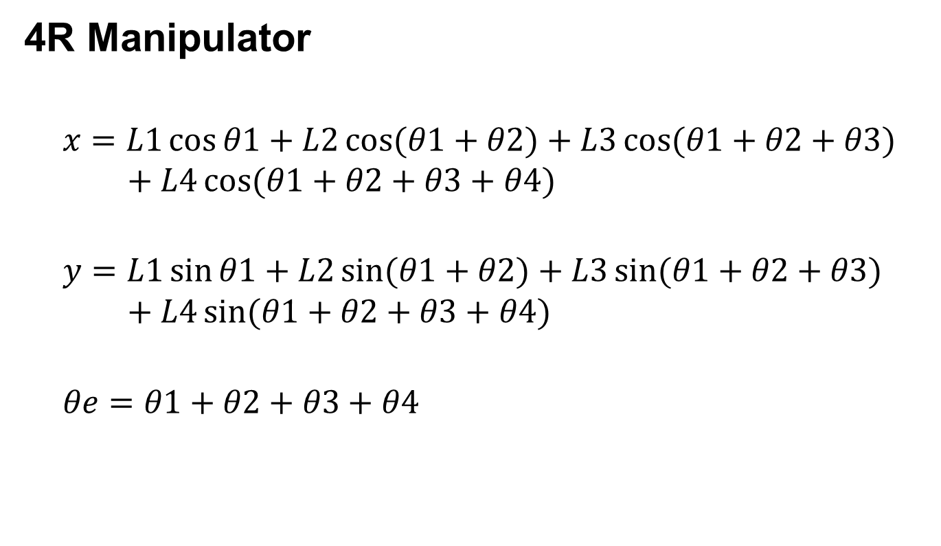
Forward Kinematics

Slide 23
Kinematics
What is Kinematics
What are the two types
What is a planar manipulators

Slide 24
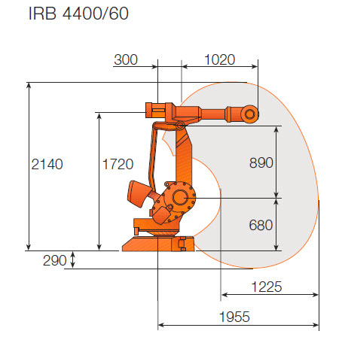
Work Volume

Slide 25
Work Volume
Work volume of RP manipulator
y
(x,y)
Ѳe
d
Ѳ
x
Work Volume

Slide 26
Work Volume
Sketch work volume of RP manipulator if Ѳ can move between 0 and 135˚ and d can vary between 1.2m and 2.5m

Slide 27
Work Volume
y
Ѳe
d
Work Volume
Ѳ
x
135˚
1.2m
2.5m

